Slide 1
CHAPTER-7 Lubrication & Journal Bearings
Tribhuwan University
Institute of Engineering
Pulchowk Campus

Slide 2
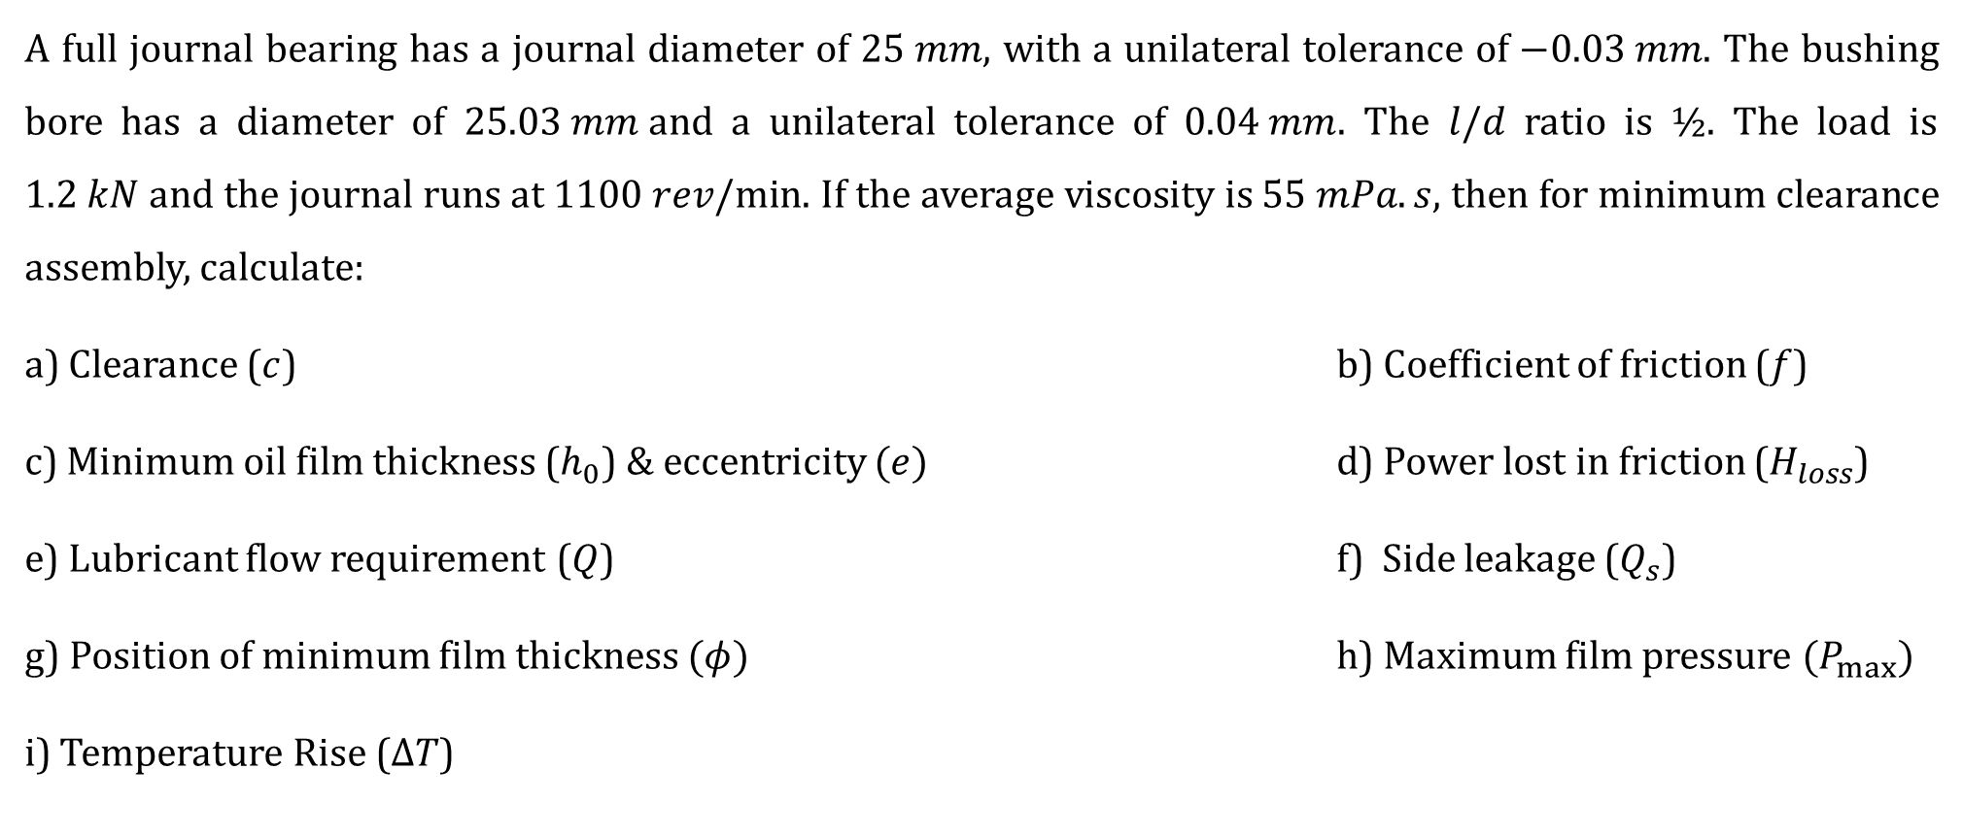

Journal bearing
A full journal bearing has a journal diameter of $25 mm$, with a unilateral tolerance of $−0.03 mm$. The bushing bore has a diameter of $25.03 mm$and a unilateral tolerance of $0.04 mm$. The $l/d$ ratio is $½$. The load is $1.2 kN$and the journal runs at $1100 rev/min$. If the average viscosity is $55 mPa.s$, then for minimum clearance assembly, calculate:
a) Clearance ($c$) b) Coefficient of friction ($f$)
c) Minimum oil film thickness ($h_{0}$) & eccentricity $(e)$ d) Power lost in friction ($H_{loss}$)
e) Lubricant flow requirement ($Q$) f) Side leakage ($Q_{s}$)
g) Position of minimum film thickness $(φ)$ h) Maximum film pressure $(P_{max})$
i) Temperature Rise ($∆T$)

Slide 3
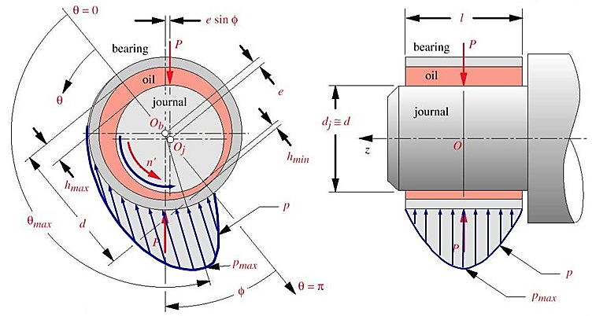

TERMS USED IN Journal bearing PROBLEM
Clearance $(c)$
Eccentricity $(e)$
Eccentricity ratio $\left(ε=\frac{e}{c}\right)$
Minimum film thickness $\left(h_{0}\right)$
Minimum film thickness variable $\left(\frac{h_{0}}{c}\right)$
Attitude angle $(φ)$
Somerfield number $\left(S={\left(\frac{r}{c}\right)}^{2}\frac{μN}{P}\right)$
Bearing Pressure/load carrying capacity $(P)$
Viscosity of lubricant $(μ)$
Journal speed $\left(N, in rev/s\right)$

Slide 4
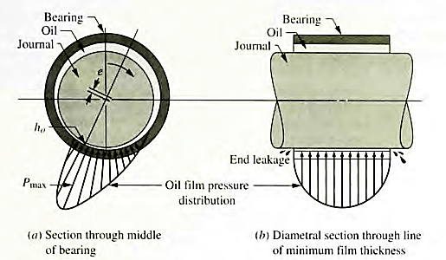

TERMS USED IN Journal bearing PROBLEM
Coefficient of friction variable CFV = $\left(\frac{r}{c}\right)f$
Flow variable, FV = $\frac{Q}{rcNl}$
Flow of the lubricant $\left(Q\right)$
Side Leakage $(Q_{s})$

Slide 5


Journal bearing SOLUTION
a) Minimum Clearance $(c)$
For Journal
Maximum diameter, $d_{max}$ = 25 mm
Minimum diameter, $d_{min}$ = 25 – 0.03 = 24.97 mm
For Bush
Minimum diameter, $D_{min}$ = 25.03 mm
Maximum diameter, $D_{max}$ = 25.03 + 0.04 = 25.07 mm
Minimum clearance ($c_{min})$
$$c_{min}=\frac{D_{min}−d_{max}}{2}$$
$$=\frac{25.03−25}{2}$$
$=0.015 mm$

Slide 6



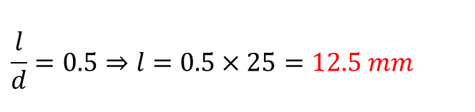

Journal bearing SOLUTION (CONTD…)
b) Coefficient of friction $(f)$
- Refer to Figure 3-5
(From Design Data Handbook)
or
- Refer to Figure 12-18
(From Shigley’s book)
Bearing Pressure, $P$
$$P=\frac{W}{ld}=\frac{W}{\left(\frac{l}{d}\right)×d^{2}}$$
$$= \frac{1200}{\left(0.5\right)×{25}^{2}}=3.84 N/mm^{2}$$
Sommerfeld Number, $S$
$$S={\left(\frac{r}{c}\right)}^{2}\frac{μN}{P}$$
$$={\left(\frac{25/2}{0.015}\right)}^{2}×\frac{55{\left(10\right)}^{−3}×1100}{60×3.84{\left(10\right)}^{6}}$$
= 0.182
$$\frac{r}{c} f=5.4$$
$$∴f=5.4×\left(\frac{0.015}{12.5}\right)=0.0065$$
$$\frac{l}{d}=0.5⇒l=0.5×25=12.5 mm$$

Slide 7
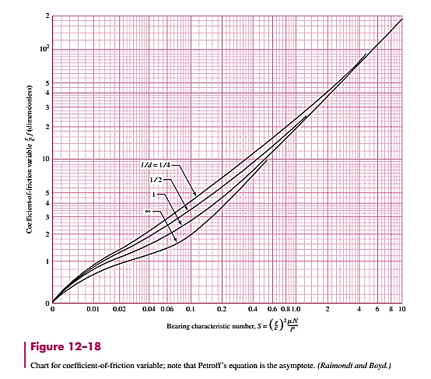


Coefficient of friction variable, CFV
We have,
$$\frac{l}{d}=0.5$$
$$S=0.182$$
From Chart,
$$CFV=\frac{r}{c} f=5.4$$
5.4
BACK

Slide 8



Journal bearing SOLUTION (CONTD…)
c) Minimum oil film thickness $(h_{0})$
$$\frac{h_{0}}{c} =0.3$$
$$∴h_{0}=0.3×0.015=0.0045 mm$$
- Refer to Figure 3-1
(From Design Data Handbook)
or
- Refer to Figure 12-16
(From Shigley’s book)
Also,
$$\frac{e}{c} =0.7$$
$$∴e=0.7×0.015=0.0105 mm$$

Slide 9
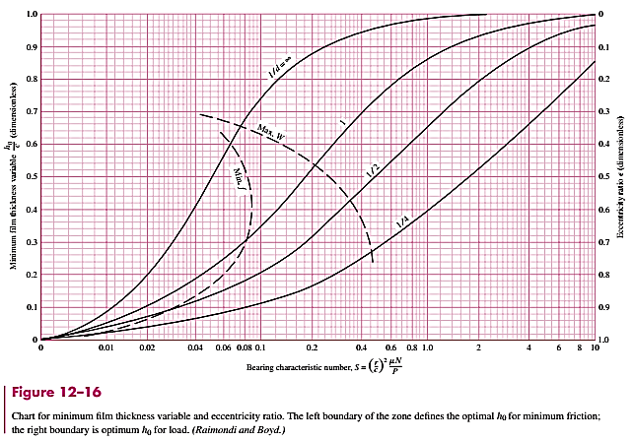
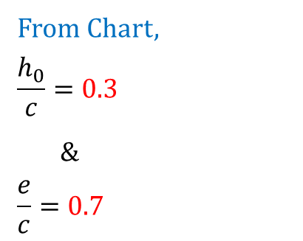


Minimum film thickness variable $\left(\frac{h_{0}}{c}\right)$
&
Eccentricity ratio $\left(\frac{e}{c}\right)$
We have,
$$\frac{l}{d}=0.5$$
$$S=0.182$$
From Chart,
$$\frac{h_{0}}{c}=0.3$$
&
$$\frac{e}{c}=0.7$$
0.3
0.7
BACK

Slide 10



Journal bearing SOLUTION (CONTD…)
d) Power lost in the friction $(H_{loss})$
Friction Torque on the journal, T
$$T=fWr$$
$∴T=0.0065×1200×0.0125=0.0975$ Nm
(From Design Data Handbook)
Refer to Equation 3- 3
Refer to Equation 3- 4
Power loss, $H_{loss}$
$$H_{loss}=2πNT$$
$∴H_{loss}=2π×\frac{1100}{60}×0.0975=$11.23 W

Slide 11


Journal bearing SOLUTION (CONTD…)
e) Lubricant flow requirement $(Q)$
Lubricant Flow requirement
$$\frac{Q}{rcNl}=5.1$$
$$∴Q=5.1×12.5×0.015×\frac{1100}{60}×12.5=219{ mm}^{3}/s$$
- Not available (To be added)
(From Design Data Handbook)
or
- Refer to Figure 12-19
(From Shigley’s book)

Slide 12
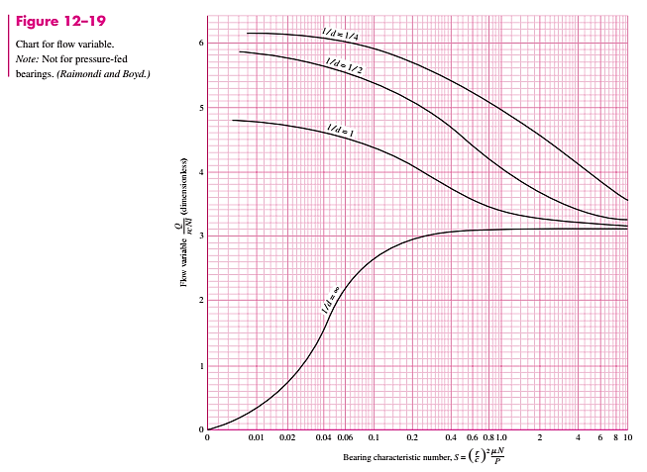
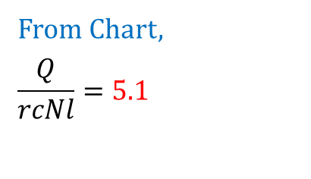
Flow variable (FV)
5.1
We have,
$$\frac{l}{d}=0.5$$
$$S=0.182$$
From Chart,
$$\frac{Q}{rcNl}=5.1$$
BACK

Slide 13


Journal bearing SOLUTION (CONTD…)
f) Side Leakage $(Q_{s})$
Side Leakage
$$\frac{Q_{s}}{Q}=0.81$$
$$∴Q_{s}=0.81×219=177.39{ mm}^{3}/s$$
- Not available (To be added)
(From Design Data Handbook)
or
- Refer to Figure 12-20
(From Shigley’s book)

Slide 14
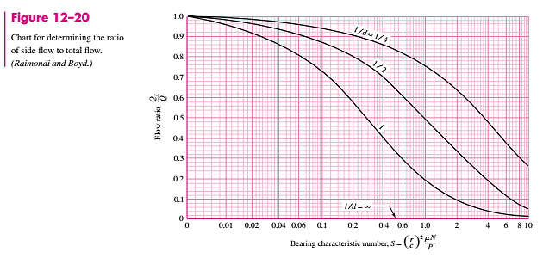
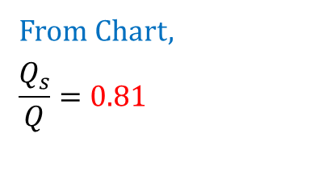
Side Leakage Flow
We have,
$$\frac{l}{d}=0.5$$
$$S=0.182$$
0.81
From Chart,
$$\frac{Q_{s}}{Q}=0.81$$
BACK

Slide 15

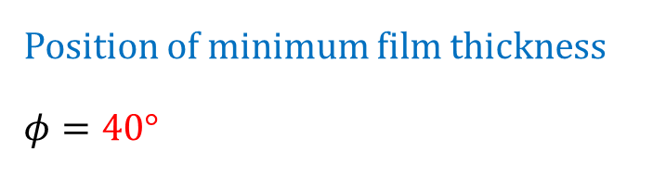
Journal bearing SOLUTION (CONTD…)
g) Position of minimum film thickness $(φ)$
Position of minimum film thickness
$$φ=40°$$
- Refer to Figure 3-2
(From Design Data Handbook)
or
- Refer to Figure 12-17
(From Shigley’s book)

Slide 16
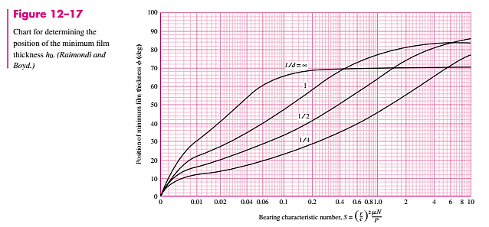

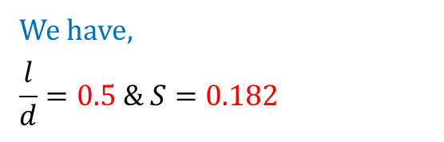
Position of minimum film thickness
We have,
$$\frac{l}{d}=0.5 \& S=0.182$$
40
From Chart,
$$φ=40°$$
BACK

Slide 17


Journal bearing SOLUTION (CONTD…)
h) Maximum film pressure $(P_{max})$
Maximum film pressure
$$\frac{P}{P_{max}}=0.32$$
$$∴P_{max}=\frac{P}{0.32}=\frac{3.84}{0.32}=12 N/mm^{2}$$
- Refer to Figure 3-3
(From Design Data Handbook)
or
- Refer to Figure 12-21
(From Shigley’s book)

Slide 18
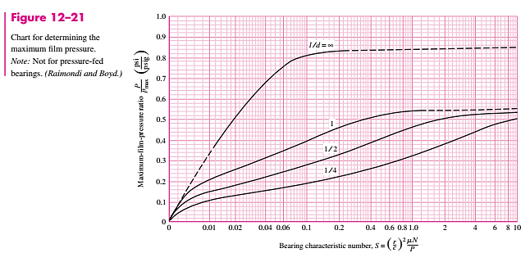
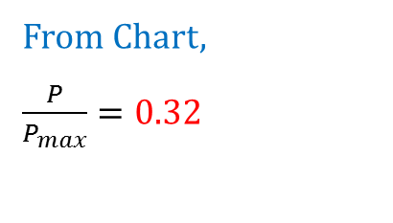
Maximum film pressure
We have,
$$\frac{l}{d}=0.5$$
$$S=0.182$$
From Chart,
$\frac{P}{P_{max}}=0.$32
0.32
BACK

Slide 19



Journal bearing SOLUTION (CONTD…)
i) Temperature Rise $(∆T)$
Temperature Rise
$$∆T=\frac{8.3P\left(CFV\right)}{(FV)}$$
$$∴∆T=\frac{8.3×3.84×5.4}{5.1}=33.75°C$$
CFV = $\left(\frac{r}{c}\right)f=5.4$
FV = $\frac{Q}{rcNl}=5.1$

Slide 20
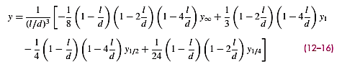

NOTE
When sometimes $l/d$ ratio is other than ones given in the chart, the following interpolation method must be used:

Slide 21
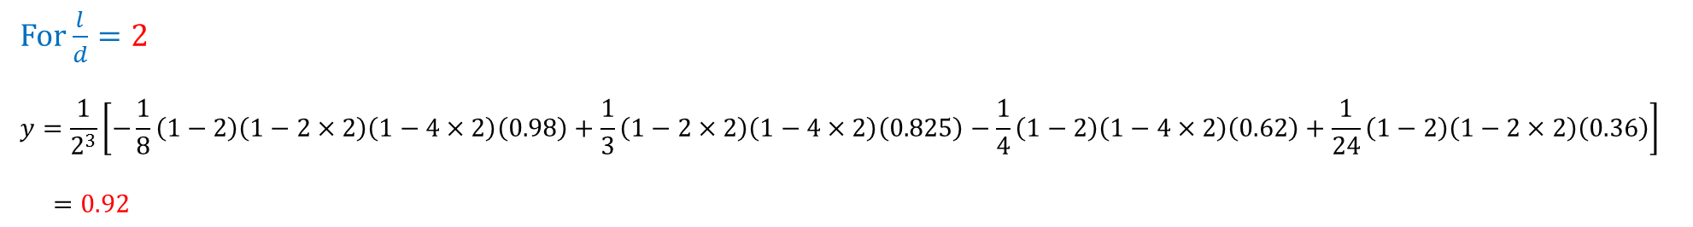


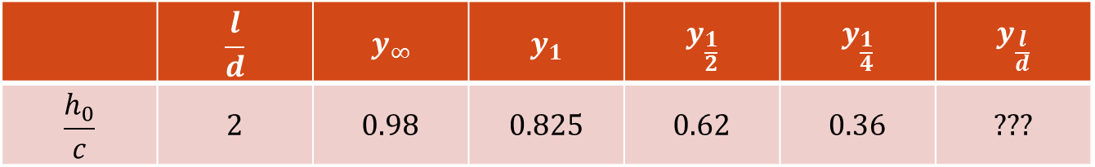
EXAMPLE OF l/d > 1
Let us assume the following case and we are to determine minimum film thickness
$$\frac{l}{d}=2 , S=0.8 \& c=0.015 mm$$
Refer Figure 12-16
Minimum film thickness
$$\frac{h_{0}}{c} =0.92$$
$$∴h_{0}=0.92×0.015=0.0138 mm$$
 | $$\frac{l}{d}$$ | $$y_{∞}$$ | $$y_{1}$$ | $$y_{\frac{1}{2}}$$ | $$y_{\frac{1}{4}}$$ | $$y_{\frac{l}{d}}$$
$$\frac{h_{0}}{c}$$ | 2 | 0.98 | 0.825 | 0.62 | 0.36 | ???
0.92
For $\frac{l}{d}=2$
$$y=\frac{1}{2^{3}}\left[−\frac{1}{8}\left(1−2\right)\left(1−2×2\right)\left(1−4×2\right)\left(0.98\right)+\frac{1}{3}\left(1−2×2\right)\left(1−4×2\right)\left(0.825\right)−\frac{1}{4}\left(1−2\right)\left(1−4×2\right)\left(0.62\right)+\frac{1}{24}\left(1−2\right)\left(1−2×2\right)\left(0.36\right)\right]$$
$=0.92$

Slide 22





0.98
Pick up the value of $\frac{h_{0}}{c}$ corresponding to S = 0.8 for $\frac{l}{d}$ = ¼, ½, 1 and $∞$
0.825
0.62
For $\frac{l}{d}=\frac{1}{4}$
$$\frac{h_{0}}{c}=0.36$$
For $\frac{l}{d}=\frac{1}{2}$
$$\frac{h_{0}}{c}=0.62$$
0.36
For $\frac{l}{d}=1$
$$\frac{h_{0}}{c}=0.825$$
For $\frac{l}{d}=∞$
$\frac{h_{0}}{c}=0.$98
BACK

Slide 23
THANK YOU

